Slide 1
Regional and Diachronic Variation in the Textual Reception of the Chronicle of Matthew of Edessa
Anahit Safaryan
University of Vienna

Slide 2
Object
The Chronicle of Matthew of Edessa (11th-12th centuries) and its textual reception. It covers 10th-12th centuries (952/953-1128/1129). The Chronicle was continued by Grigor Erēc‛ (the years of 1136/1137-1162/63).
It’s an important source for 10-12th centuries Near Eastern history.
There are 35 manuscripts that contain full or substantial texts of the Chronicle and 6 manuscripts containing excerpts of it now being kept in around 10 countries.
The known manuscripts were copied at least in twelve different cities from the end of the 16th century till the 19th century.

Slide 3
Hypothesis
My hypothesis is that scribes of the manuscripts should be treated the same way as authors.
I suggest, that instead of only reconstructing the original text, we take into account all information that exists in the manuscript tradition of any medieval historical work and try to distinguish the author of the information as certainly, as possible. So, we should, on one hand, restore the original text, on the other hand, find the authors of the information that was not part of the original text, but exists in one or more manuscripts of the work. Then the information should be analyzed taking into account its author, the author’s life, perspectives, sources etc. And only after the analysis, we will be able to estimate the value of the source, in general, and the value of distinct parts of the work, in particular.

Slide 4
Case study on the sequence of the kings of Kars (963-1064/1065)

Slide 5
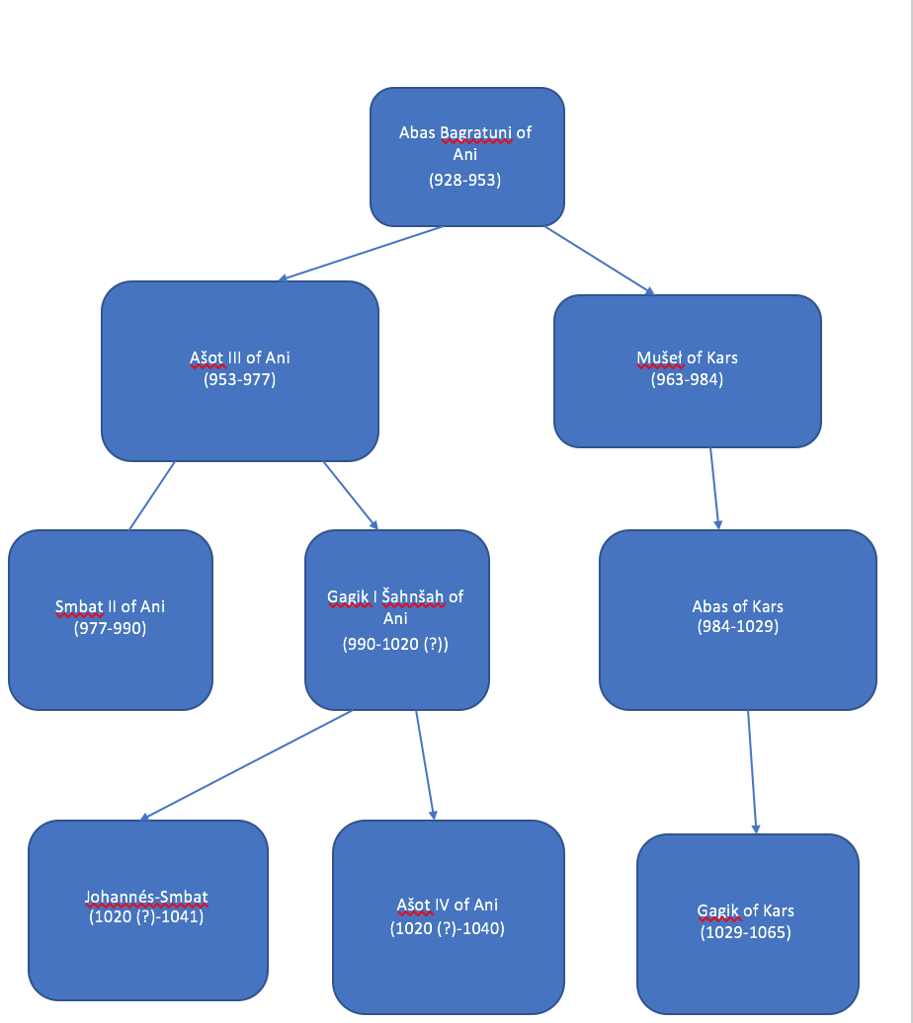
More accepted theory

Slide 6
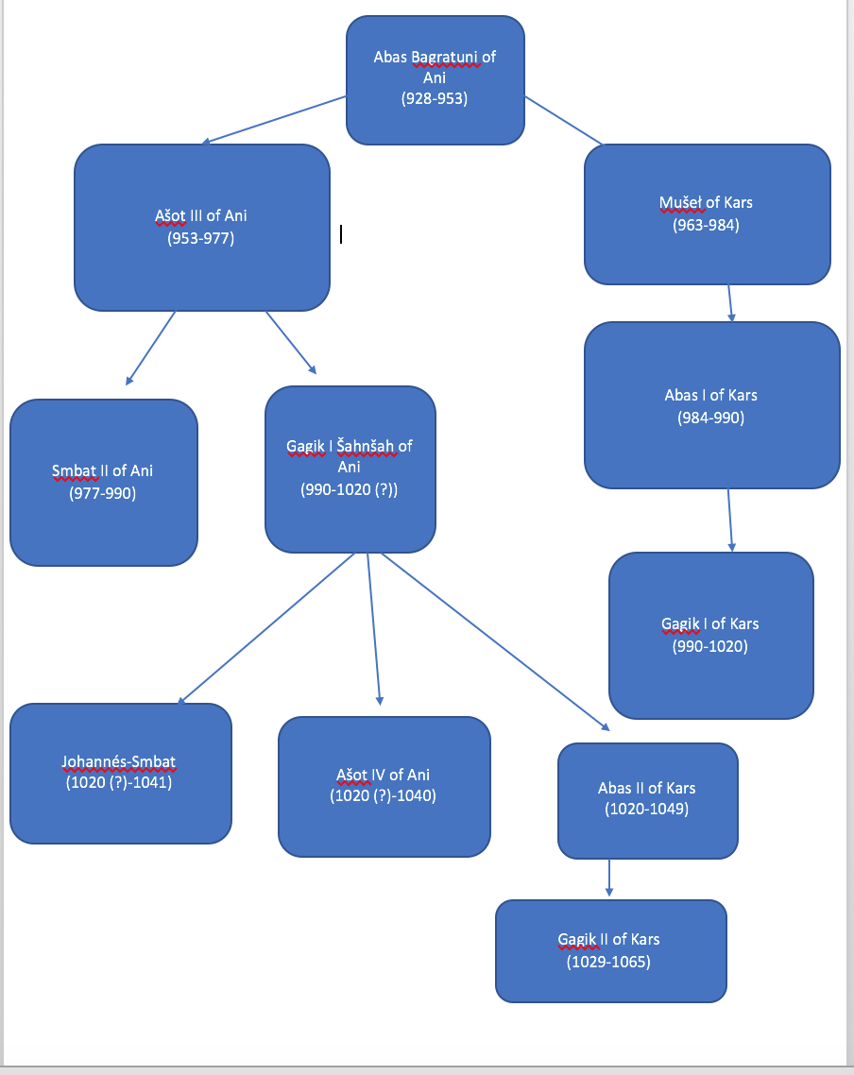
The theory of R. Mateosyan

Slide 7
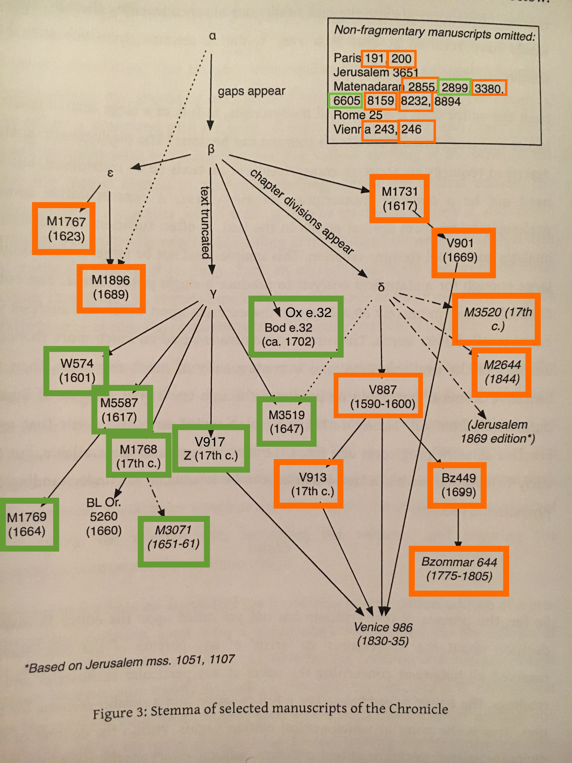
Notes:
T. L. Andrews, ‘Digital Techniques for Critical Edition’, in Armenian Philology in the Modern Era: From Manuscript to Digital Text, edited by V. Calzolari and M. E. Stone (Leiden: Brill, 2014), pp. 191.

Slide 8
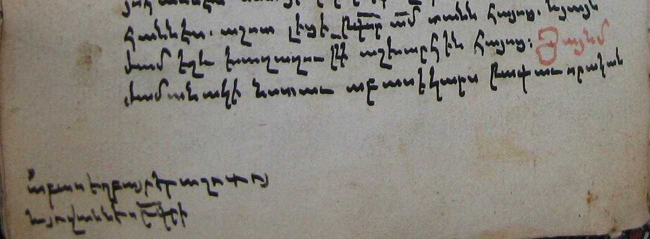
Ox e.32

Slide 9
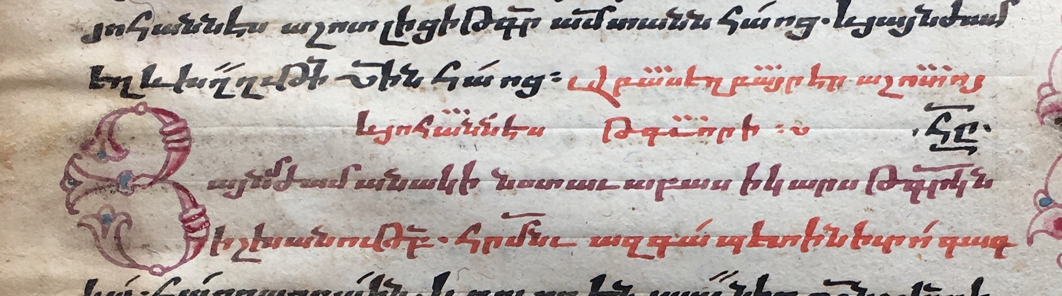
W574

Slide 10
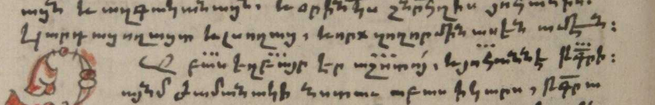
M3519

Slide 11
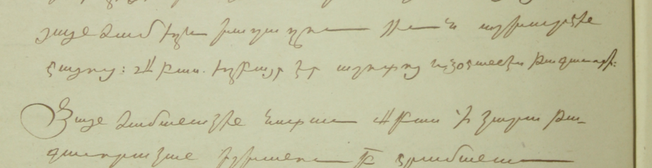
M2899

Slide 12
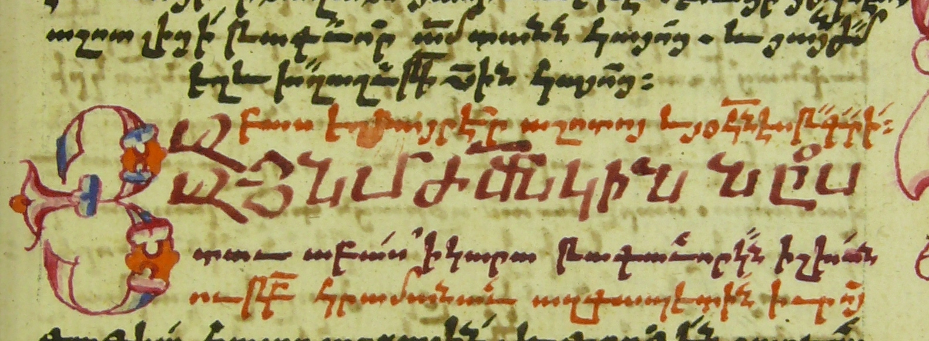
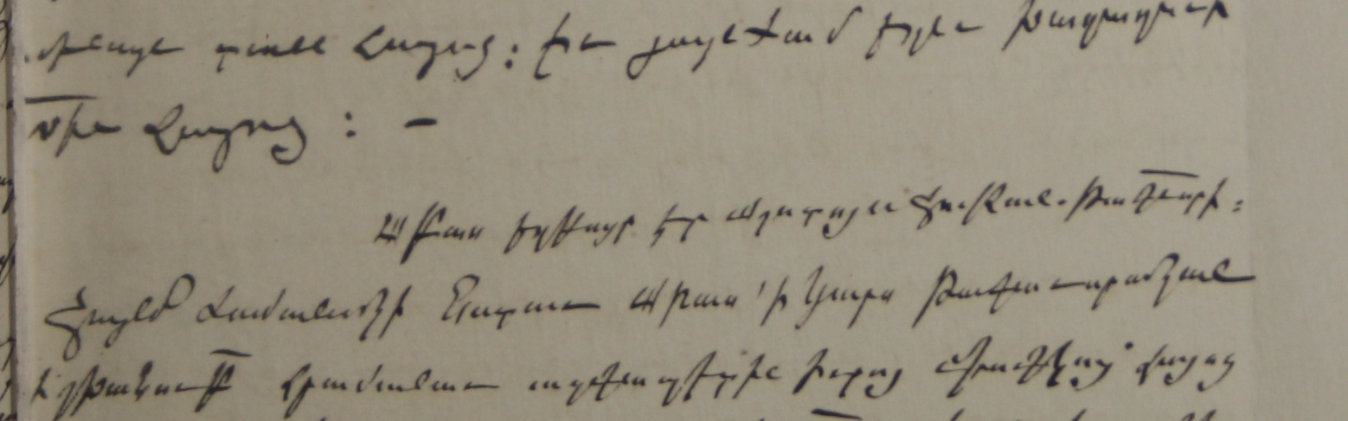
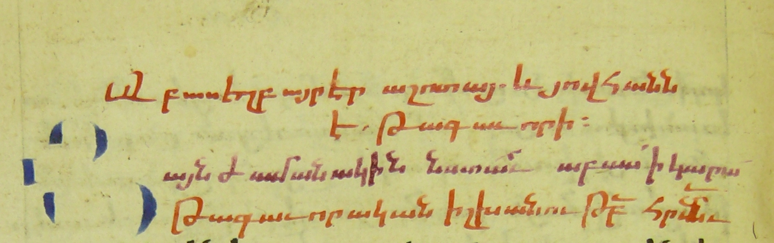
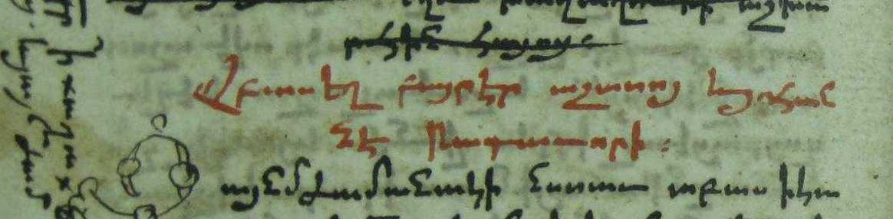
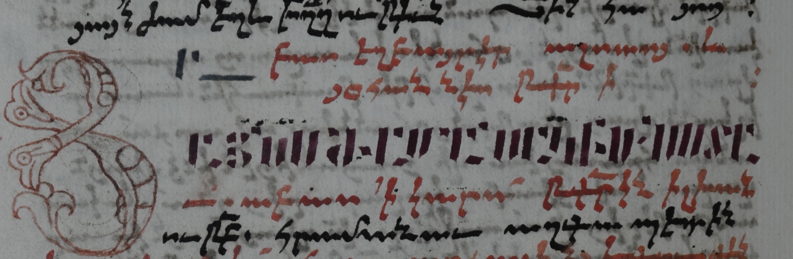
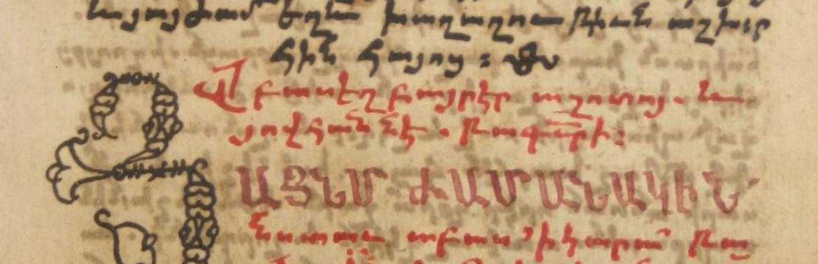

Slide 13
Other facts
The Chronicle of Matthew of Edessa is not very trustful source on this period (according to the Chronicle 421 Arm Era; 972/973 AC, but 1020s in fact)
There are 2 inscriptions (an inscription by Queen Katranide in 1010 and an inscription by bishop of Arsharuniq in Horomos in 1013) proving the existense of the son Gagik Šahnšah called Abas.
13th century author Vardan Vardapet in his “Historical Compilation” speaks about Abas as a third son of Gagik who inherited some part of the country.

Slide 14
Conclusions on the case study
Matthew of Edessa is not the author of the sentence discussed above.
We should consider it as a primary source and analyze it as we do not know the author (thus, we do not know the source of it, the perspectives etc.).

Slide 15
Purpose
Trying to separate the information existing in the manuscript tradition of the Chronicle of Matthew of Edessa according to its author, which may be Matthew or a scribe, and analyzing them from the perspective of historical sciences. From this point, my thesis may be interesting for the researchers who study Near Eastern and, especially, Armenian history of 10-12th centuries.
Trying to prove my hypothesis on the importance of analyzing the information existing in the textual reception of any medieval historical work and which was not written by the main author. I will analyze cases studies from the Chronicle of Matthew of Edessa to get results for my hypothesis. In both cases, if my hypothesis is proved or not, this may be of some interest for the textual scholars, in general, despite of the narrow field of their research.
Presenting some of the results of the Project “The Chronicle of Matthew of Edessa Online” along with other publications by me or my colleagues preceding my thesis. This may be of some usefulness for the textual scholars who are interested in computational methods for text analysis and digital critical editions.

Slide 16
Intended schematic structure
1.The Chronicle of Matthew of Edessa and history of its study. New publication of the it: The Project “The Chronicle of Matthew of Edessa Online”
2.Matthew of Edessa and his perspectives
3. Digital methods for stemmatic analysis: Stemma of the manuscripts of the Chronicle
4.Manucscript tradition of the Chronicle
5.Variations in the manuscripts of the Chronicle
One possible chapter may present the comparison of the texts on the same years in Chronicle of Matthew of Edessa and in the Chronicle of Smbat the Constable considering the variations in manuscript traditions of both works.

Slide 17
Data
30 manuscripts of the Chronicle fully transcribed and marked up with TEI XML tags.

Slide 18
Methods: Quantitative method/Distant reading
Case study on the month names used in the Chronicle (Armenian and Roman)

Slide 19
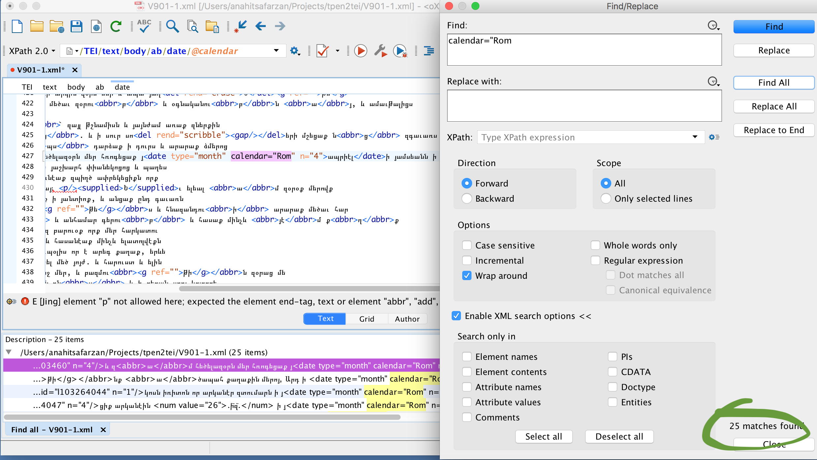
Roman names of months-25

Slide 20
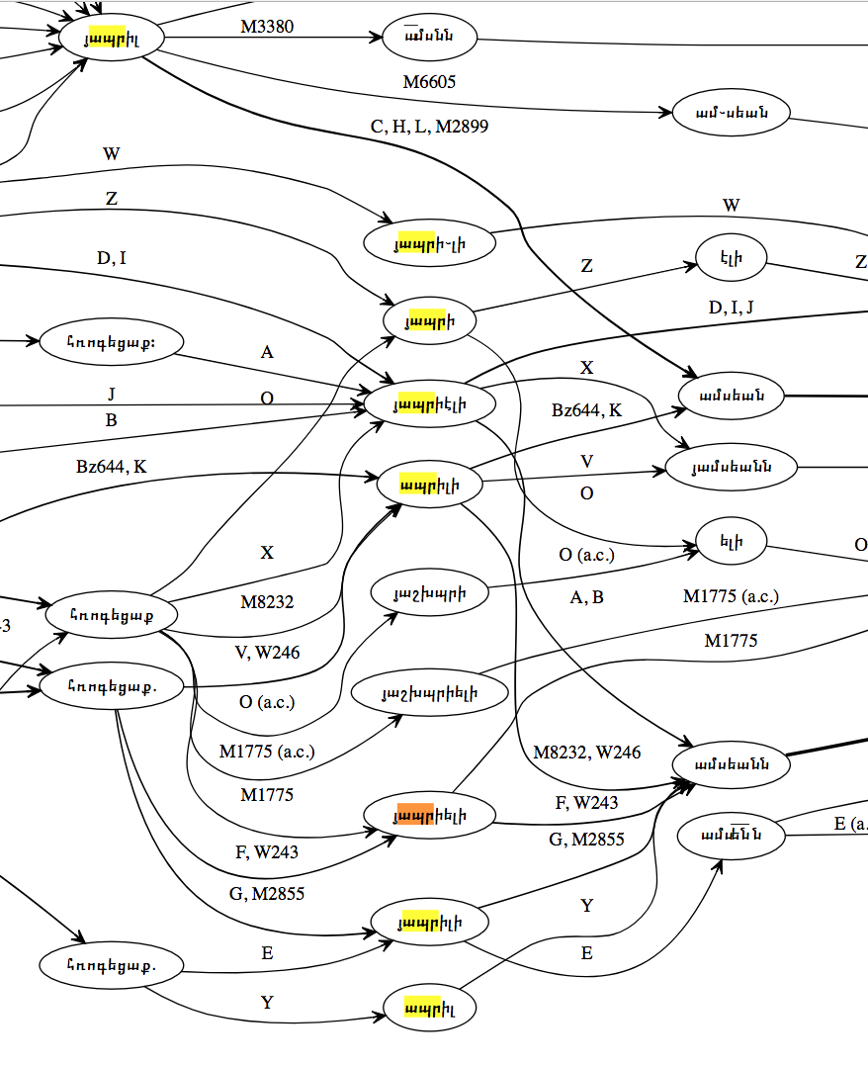
April

Slide 21
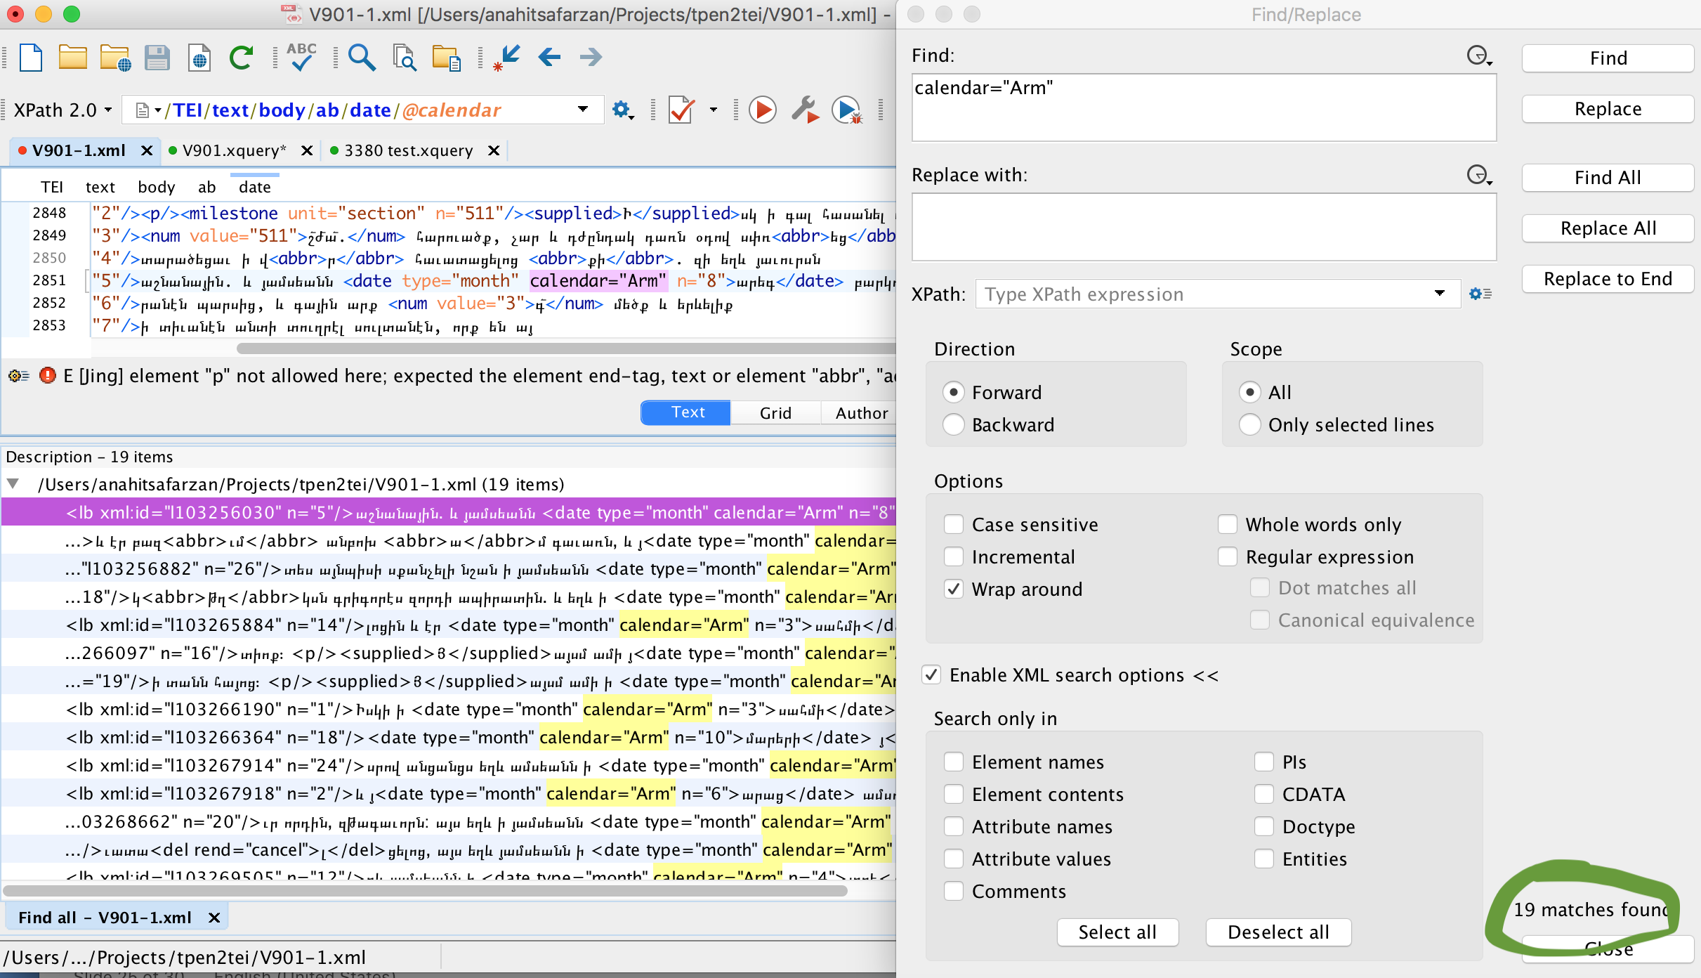
Armenian names of months-19

Slide 22
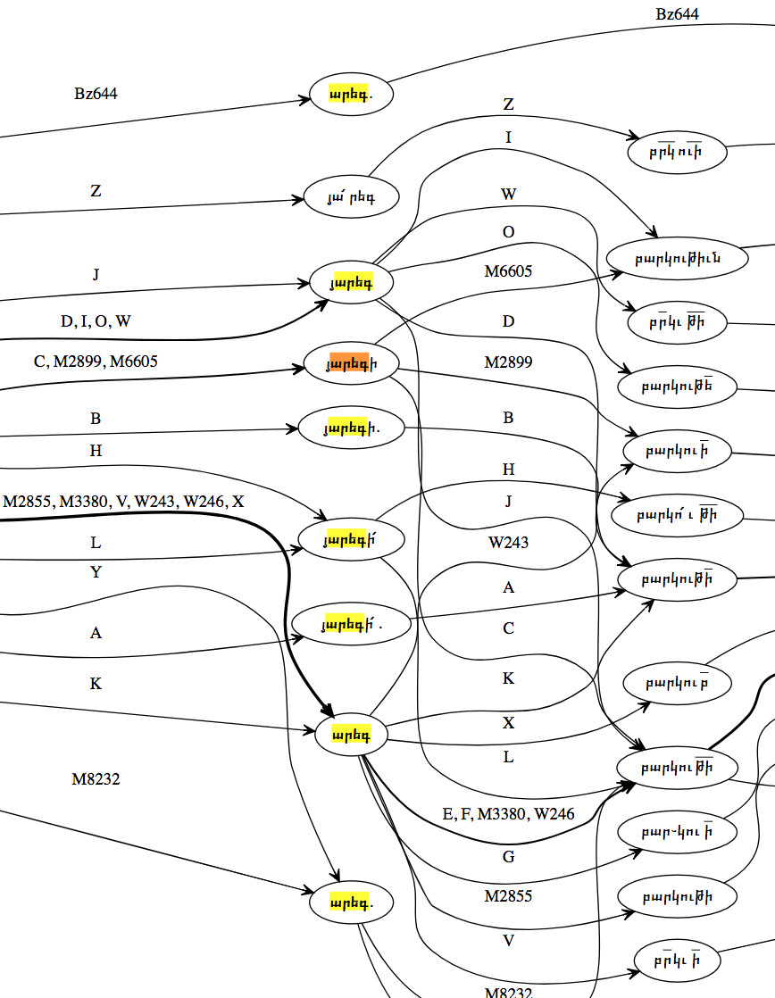
Areg (th month in Arm. Calendar)

Slide 23
Qualitative method/Close reading
What was the reason that Gagik of Kars decided to exchange Kars with some territories in Byzantium (Camndav etc.) and how Matthew of Edessa tells this story?
1.Find out the reasons of Gagik’s deed based on the Chronicle and other sources.
2.Find out the perspectives of Matthew to interpret the story the way he does.

Slide 24
Time schedule
Period | Project | Thesis
Summer 2018 | Creating the stemma of the manuscripts of the Chronicle. | Preparing the material for the third chapter of my thesis (devoted to the stemma).
Autumn 2018 and winter 2018-2019 | Editing the Chronicle. | Preparing the material for the second (perspectives of Matthew and historical events described by him), fourth (scribes), fifth (variations in the manuscripts) and sixth (distinct cases of variations in the manuscripts) chapters.
Spring 2019 | Preparing the publication of the Chronicle. | Preparing the material for the first chapter (general information about the Chronicle including editions, translations etc.).
Summer and autumn 2019 |  | Completing the missing information on each chapter, studying the gathered materials and writing the thesis.

Slide 25
Bibilography
Primary sources
Anna Komnenē. The Alexiad. Translated by E. R. A. Sewter and Peter Frankopan, 2009.
Aristakes Lastivertc’i. History. Translated from Classical Armenian by Robert Bedrosian, 1985.
Constantine Porphyrogenitus. De Administrando Imperio. 1993.
Greenwood, Tim. The Universal History of Step’anos Tarōnec’i: Introduction, Translation, and Commentary. Oxford University Press, 2017.
Ibn-al-Aṯīr, ʿIzz al-Dīn. The Annals of the Saljuq Turks: Selections from Al-Kāmil Fī ’L-Taʾrīkh of ʿIzz Al-Dīn Ibn Al-Athīr. Translated by D. S. Richards, 2002.
Ibn-al-Aṯīr, ʿIzz-ad-Dīn Abu-’l-Ḥasan ʿAlī. The Chronicle of Ibn Al-Athīr for the Crusading Period from Al-Kāmil Fī’l-Ta’rīkh: Pt. 1 : The Years 491 - 541 / 1097 - 1146 ; the Coming of the Franks and the Muslim Response. 1. publ. in pbk.., Ashgate, 2010.
Michael the Syrian. Chronicle of Michael the Great, Patriarch of the Syrians. Translated from the Classical Armenian editions of Jerusalem, 1870 and Jerusalem, 1871 by Robert Bedrosian, 2013. Internet Archive, http://archive.org/details/ChronicleOfMichaelTheGreatPatriarchOfTheSyrians.
Skylitzēs, Iōannēs. A Synopsis of Byzantine History, 811–1057. Translated by J. Wortley, Cambridge University Press, 2010.
Smbat Sparapet. Chronicle. Translated from Classical Armenian by Robert Bedrosian, 2005. Internet Archive, http://archive.org/details/SmbatSparapetsChronicle.

Slide 26
Secondary sources
Abrahamian, Ashot. Hayoc‛ gir yew grč‛owt‛yown (Armenian Script and Written Language). Yerevan State University Publishing House, 1973.
Adjarian, Hrachia. Hay barbar̊agitowtown (Armenian Dialectology). 1911, http://www.nayiri.com/imagedBook.jsp?id=1.
---. Hayerēn armatakan bar̊aran (Dictionary of Armenian roots). 1971, http://www.nayiri.com/imagedDictionaryBrowser.jsp?dictionaryId=7.
---. Hayerēn Gawar̊akan Bar̊aran (Armenian Dialectal Dictionary). 1913, http://www.nayiri.com/imagedDictionaryBrowser.jsp?dictionaryId=31.
Andrews, Tara L. Mattʿēos Uṙhayecʿi and His Chronicle: History as Apocalypse in a Crossroads of Cultures. BRILL, 2016.
---., ‘Digital Techniques for Critical Edition’, in Armenian Philology in the Modern Era: From Manuscript to Digital Text, edited by V. Calzolari and M. E. Stone (Leiden: Brill, 2014), pp. 191.
Kouymjian, Dikran. “Armenian Paleography: A Reassessment.” Scribes et Manuscrits Du Moyen-Orient., 1997, pp. 177–88.
Matewosyan, R. Bagratownyac’ Hayastani Petakan Kaṙowc’vack’n Ow Varč’akan Karg. 1990.
Reynolds, L. D., and N. G. Wilson. Scribes and Scholars: A Guide to the Transmission of Greek and Latin Literature. 3rd ed, Clarendon Press ; Oxford University Press, 1991.
Stone, Michael E., et al. Album of Armenian Paleography. 2002.

Slide 27
Thank you for attention! ☺

